Slide 1
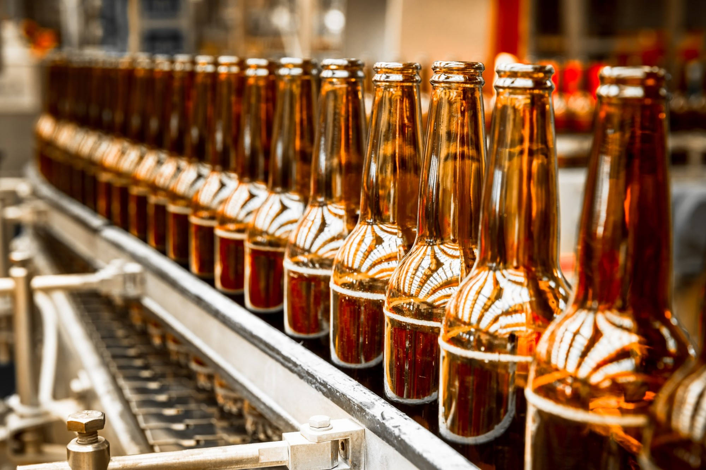
BEER RECOMMENDER

Slide 2

THE MAGIC
Thank you

Slide 3
BEER STYLE CATEGORIES
Color
Flavor
Hoppiness
Maltiness
Fruitiness
Body
Sweetness
Sour
Spicy
Bitter
Aroma
Custom flavor

Slide 4
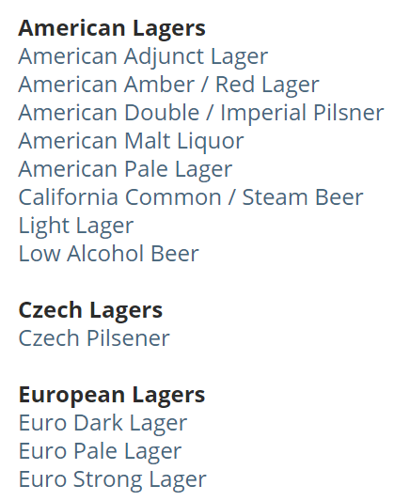
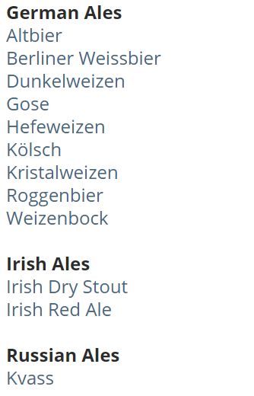
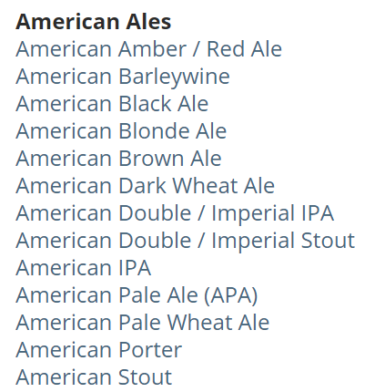
SCRAPE
BEER STYLES

Slide 5
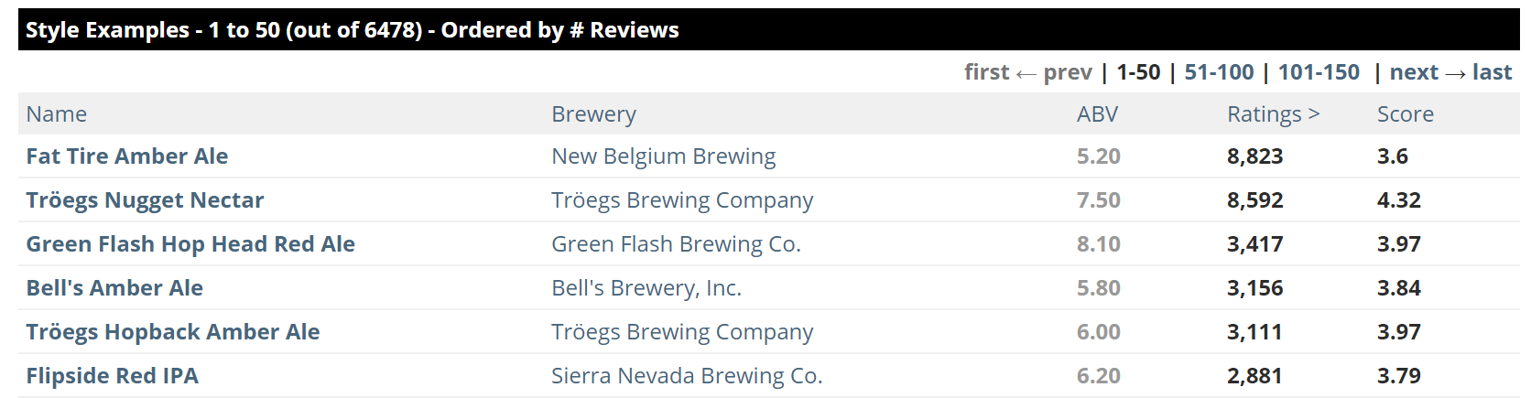
SCRAPE
BEERS

Slide 6
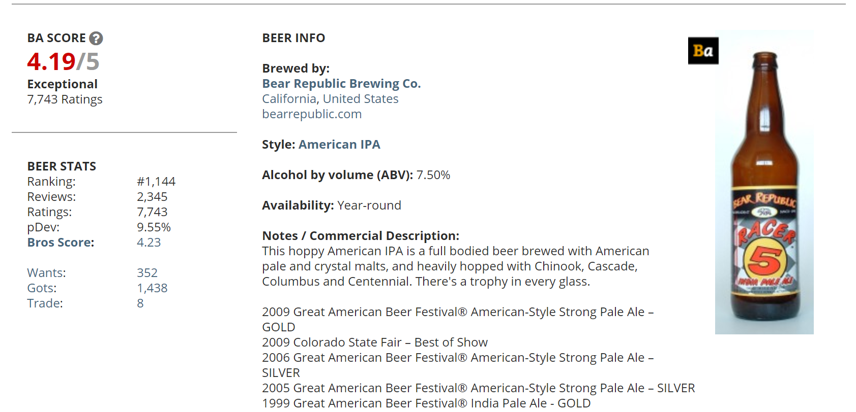
AND SCRAPE SOME MORE
BEER FEATURES

Slide 7
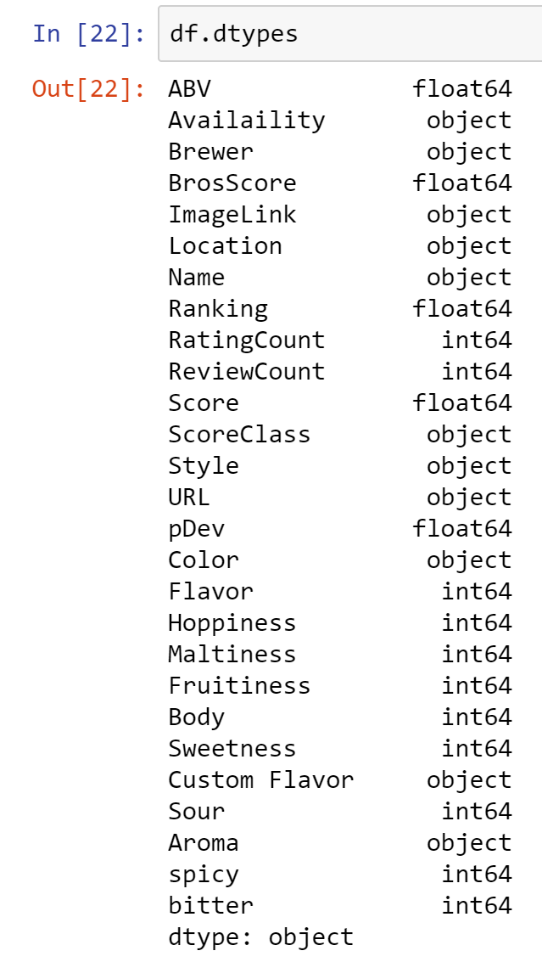

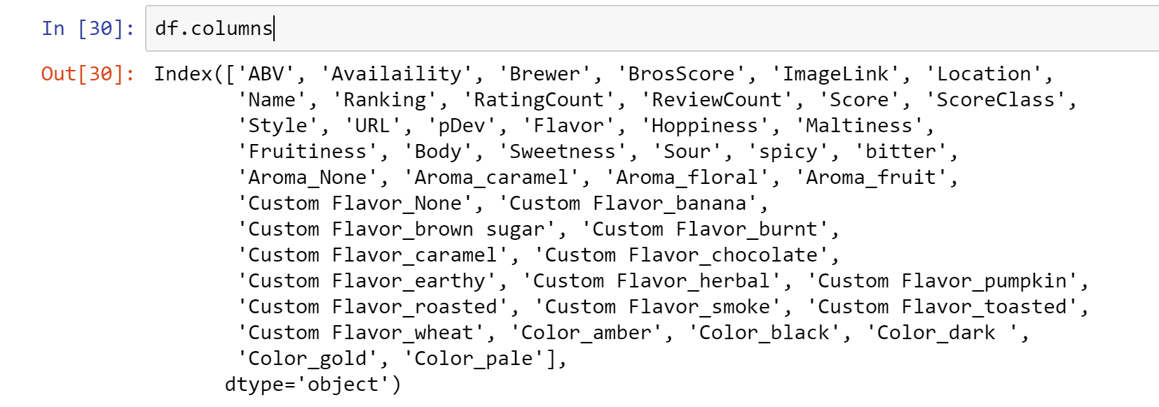
ONE HOT ENCODING, THE PANDAS WAY

Slide 8
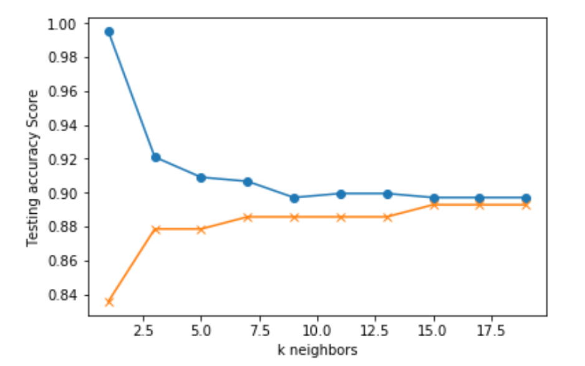
MACHINE LEARNING MODELS
KNN
DECISION TREES
RANDOM FOREST

Slide 9
ALL THAT IS GOOD
5% 10%

